Slide 1



Lung Cancer Prediction
SURESH BABU K
22ADR107
AIDS - B

Slide 2
Project Overview
Early detection of lung cancer is hindered by the lack of accessible and efficient diagnostic tools, making it difficult for individuals to identify their condition in its initial stages.
Traditional diagnostic methods are often costly, time-consuming, and inaccessible to many, limiting timely intervention and increasing the risk of late-stage diagnosis.
A machine learning-based system that predicts lung cancer risk using health and lifestyle data can provide quick, accurate, and affordable insights, enabling early detection and improved healthcare outcomes.

Slide 3
Objective
Develop a system that recommends the most suitable job roles based on the user's skills and expertise.
Enhance the accuracy of job role recommendations by leveraging machine learning techniques for skill-based matching.
Streamline the job search process for users by providing targeted, relevant job role suggestions, reducing the time and effort spent on irrelevant opportunities.

Slide 4
Technical Stack
Front-End Technologies: React js , CSS.
Back-End Technologies: Flask, Logistic Regression, Joblib for Model Deployment.
Deployment: Vercel for hosting the frontend, render for hosting the backend.

Slide 5
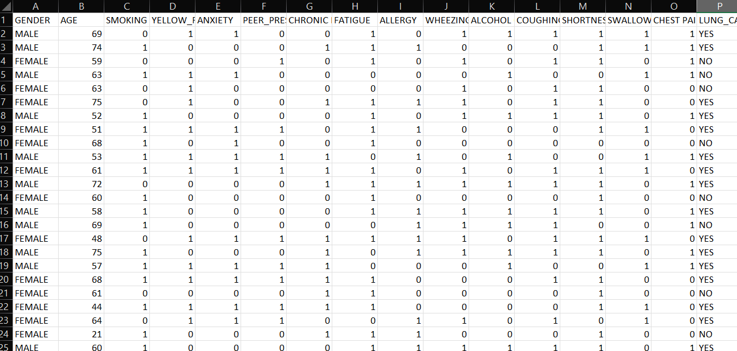
Dataset
The dataset consists of 310 rows and 16 columns.
After preprocessing the dataset 15 columns are used for training the dataset.

Slide 6
Links
Github Link : https://github.com/Suresh1208/Lung_disease_prediction
Deployment Link : https://lung-disease-prediction-six.vercel.app/

Slide 7
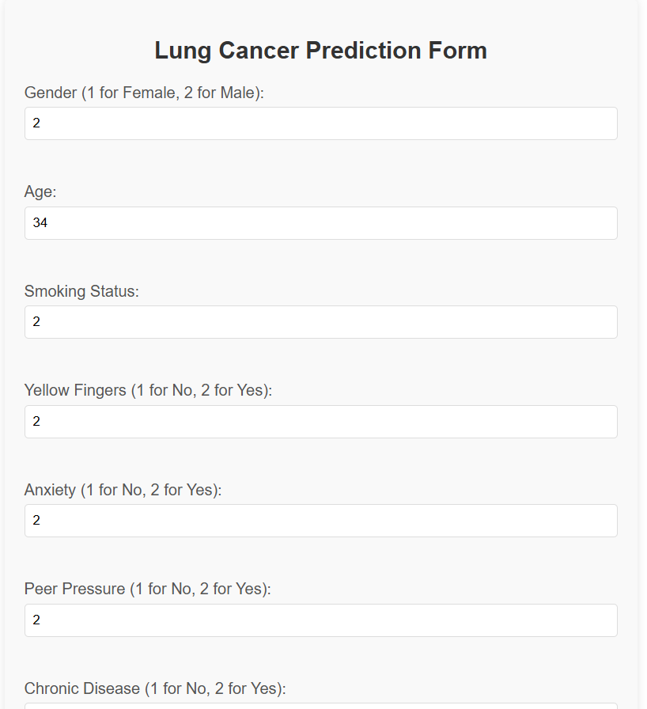
Implementation

Slide 8
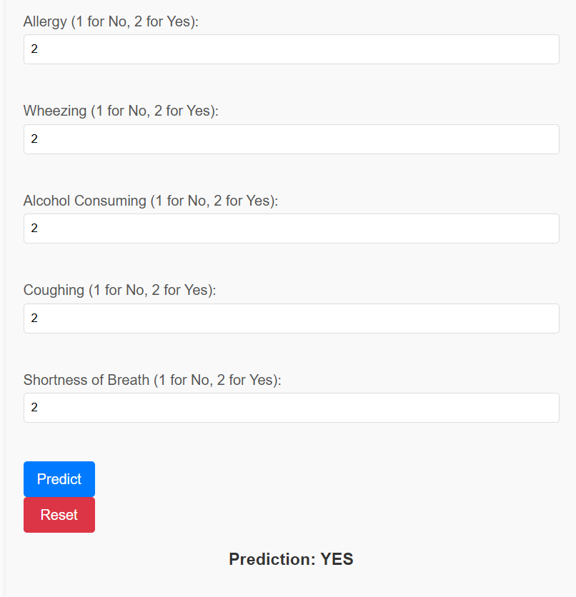
Implementation

Slide 9
THANK YOU

